Slide 1

Bare International Analysis
By Sachin gunjal

Slide 2
INTRODUCTION
This project focuses on assessing the performance of Style Advisors based on a detailed set of evaluation criteria. The assessment includes key aspects such as store ambiance, initial impressions, understanding customer needs, trial experience, and overall customer service. The main objective is to gauge the effectiveness of Style Advisors and highlight areas where improvements can be made.

Slide 3
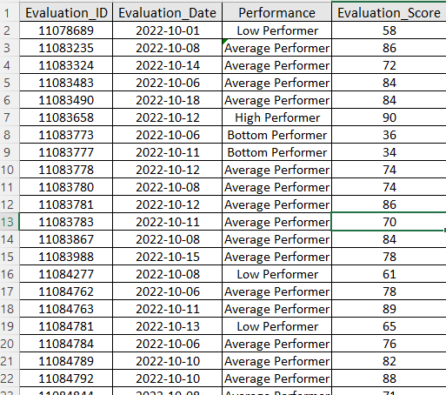
Task 1 Using the Evaluation Score, assign grades as follows: High Performer: 90% - 100% , Average Performer: 70% - 89% , Low Performer: 50% - 69% and Bottom Performer: Below 50%
Formula Used: IF(AND(D2>=90,D2<=100),"High Performer", IF(AND(D2>=70,D2<90),"Average Performer“, IF(AND(D2>=50,D2<70),"Low Performer", IF(D2<50,"Bottom Performer","Invalid Score"))))

Slide 4
Task 2 To create a pivot table that shows the average Evaluation_Score by Zone: 1. Data Preparation: Ensure the data is clean and organized. 2. Create Pivot Table: Use Excel to create a pivot table with "Zone" as the row label and average of "Evaluation_Score" as the value.
Row Labels | Average of Evaluation Score
East | 71.57142857
North | 76.73684211
South | 66.61111111
West | 71.82352941
Grand Total | 71.78688525

Slide 5
Bar Chart

Slide 6
Steps to Find the Region with the Highest Percentage of High Performers 1. Create a Pivot Table: Show counts of each performance grade by Zone. 2. Calculate Percentage: For each zone, divide the number of High Performers by the total number of evaluations. 3. Identify Region: Find the zone with the highest percentage of High Performers.
Row Labels | Average Performer | Bottom Performer | High Performer | Low Performer | Grand Total
East | 14.29% | 14.29% | 28.57% | 42.86% | 100.00%
North | 47.37% | 5.26% | 21.05% | 26.32% | 100.00%
South | 38.89% | 16.67% | 11.11% | 33.33% | 100.00%
West | 58.82% | 17.65% | 11.76% | 11.76% | 100.00%
Grand Total | 44.26% | 13.11% | 16.39% | 26.23% | 100.00%
Evaluation Score vs Zone

Slide 7
Bar Chart

Slide 8
Percentage of High Performers by Region: Pie chart showing the percentage of High Performers in each region.

Slide 9
Line Chart

Slide 10
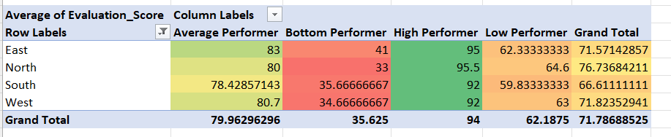
Performance Breakdown by Criteria: Heatmap showing average scores for various evaluation criteria.

Slide 11
Comparison of High vs. Low Performers: Stacked bar chart comparing characteristics of High and Low Performers.
Comparison of High vs. Low Performers: Stacked bar chart comparing characteristics of High and Low Performers.

Slide 12
INSIGHTS
Consistently High/Low Zones – Regions that maintain steady performance levels.
Top Performer Concentration – Zones with a higher share of high achievers.
Performance Trends – Score fluctuations over time, indicating improvement or decline.
Performance Distribution – Spread of grades to locate problem areas or strengths.

Slide 13
Conclusion
Based on the analysis, the management team will gain insights into the effectiveness of Style Advisors across different regions. The visualizations will provide a clear picture of performance trends, high-performing regions, and areas requiring attention. Recommendations can be made to enhance overall performance based on the identified strengths and weaknesses.

